Slide 1

Swami Keshvanand Institute of Technology, Management & Gramothan, Jaipur
Department of Computer Science and Engineering
Industrial Training Presentation
on
Submitted to:
……………………………..
Assistant Professor
Presented By: Saksham Mathur
Student Name: Saksham Mathur
Reg. No.: B231271
Semester and Year: 2nd Year 4th sem.
Session: 2025-26

Slide 2
Contents
Introduction
Objective of the project
Tools and Technology
What is Deep Learning?
Introduction To CNN?
Project Screenshots
Future work
Conclusion

Slide 3
Introduction
Face Mask Detection is a computer vision application that automatically identifies whether a person is wearing a face mask or not using deep learning techniques. In this project, we utilize Convolutional Neural Networks (CNN) for classification and OpenCV for face detection. The model is integrated into a user-friendly interface using Streamlit, allowing users to detect masks through webcam input or uploaded images in real time. This system contributes to automated monitoring and public safety, especially in high-risk environments like hospitals, schools, and public places.

Slide 4
Objective of the project
The primary objective of this project is to develop an intelligent and real-time system that can accurately detect whether a person is wearing a face mask or not.
Key Goals:
Implement a CNN model for classifying images into “Mask” and “No Mask” categories.
Integrate OpenCV for face detection using live webcam feed.
Deploy the model using Streamlit to provide a simple and interactive user interface.
Enhance public safety by automating mask detection in real-world environments.
Generate audio alerts when a face without a mask is detected (optional feature).

Slide 5
Tools and Technology
Programming Language: Python
Deep Learning Framework: TensorFlow & Keras
Computer Vision: OpenCV
Model Type: Convolutional Neural Network (CNN)
Face Detection: Haar Cascade Classifier
GUI Interface: Streamlit
Audio Feedback: pyttsx3 (Text-to-Speech)
IDE: Jupyter Notebook / VS Code
Hardware: Laptop with Webcam

Slide 6
Introduction to Deep Learning & Neural Networks
Deep Learning is a subset of Machine Learning that uses Artificial Neural Networks (ANNs) to mimic how the human brain processes information. It is powerful for handling complex tasks like image recognition, speech processing, and natural language understanding.
Types of Neural Networks
ANN (Artificial Neural Network): Basic structure of deep learning with interconnected layers of nodes (neurons).
CNN (Convolutional Neural Network): Specially designed for image and video processing. Extracts spatial features using convolution layers.
RNN (Recurrent Neural Network): Designed for sequential data like text or time series. Remembers previous outputs using feedback loops

Slide 7
Computer Vision with CNN
CNN is a Deep Learning model specially designed to process image data.
It automatically learns features like edges, colors, shapes from images using filters.
CNN helps in tasks like image classification, object detection, and facial recognition.
Object Detection (YOLO): YOLO (You Only Look Once) detects and localizes multiple objects in real-time images/videos.

Slide 8
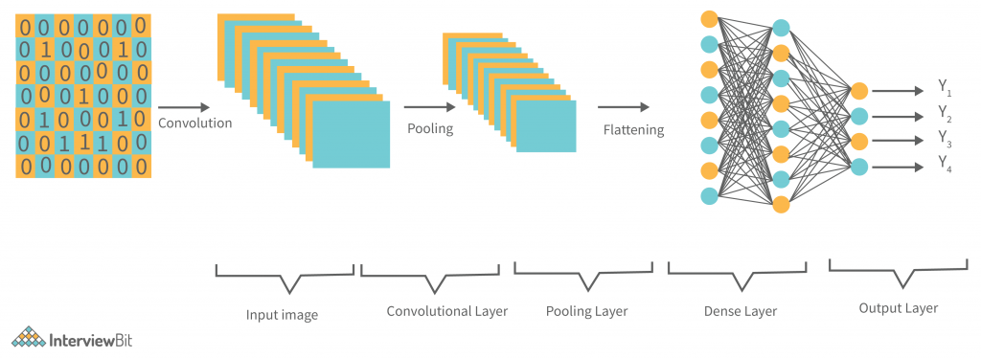
Layers of CNN:
Convolution Layer
Applies filters to extract image features
Detects edges, corners, textures
Pooling Layer (MaxPooling)
Reduces image size to speed up computation
Keeps important features only
Flatten Layer
Converts 2D data into 1D vector
Prepares for fully connected layer
Fully Connected (Dense) Layer
Learns high-level features
Makes final prediction (Mask / No Mask)

Slide 9
How It Works
Image Capture
The system captures real-time frames using a webcam.
Face Detection
OpenCV detects faces from the frame using Haar Cascade or DNN.
Preprocessing
Each detected face is resized and normalized for the CNN model.
Prediction (CNN Model)
The trained Convolutional Neural Network classifies the face as:
With Mask
Without Mask
Display Output
Bounding boxes and labels are drawn:
Green box: Mask detected ✅
Red box: No mask detected ❌

Slide 10


Slide 11
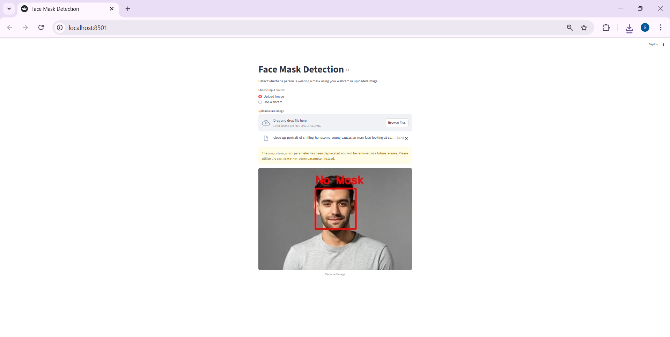

Slide 12


Slide 13
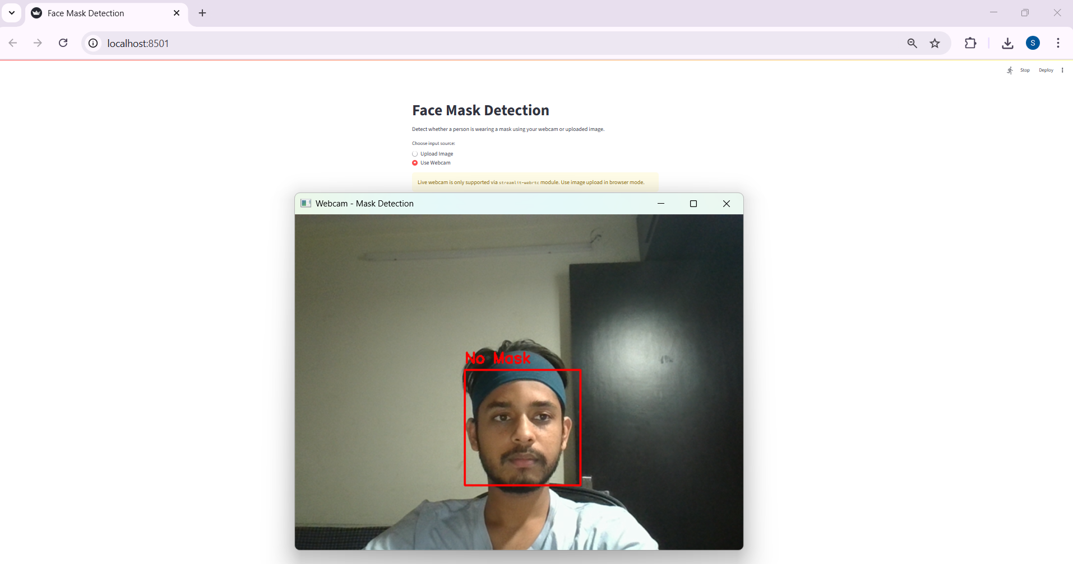

Slide 14
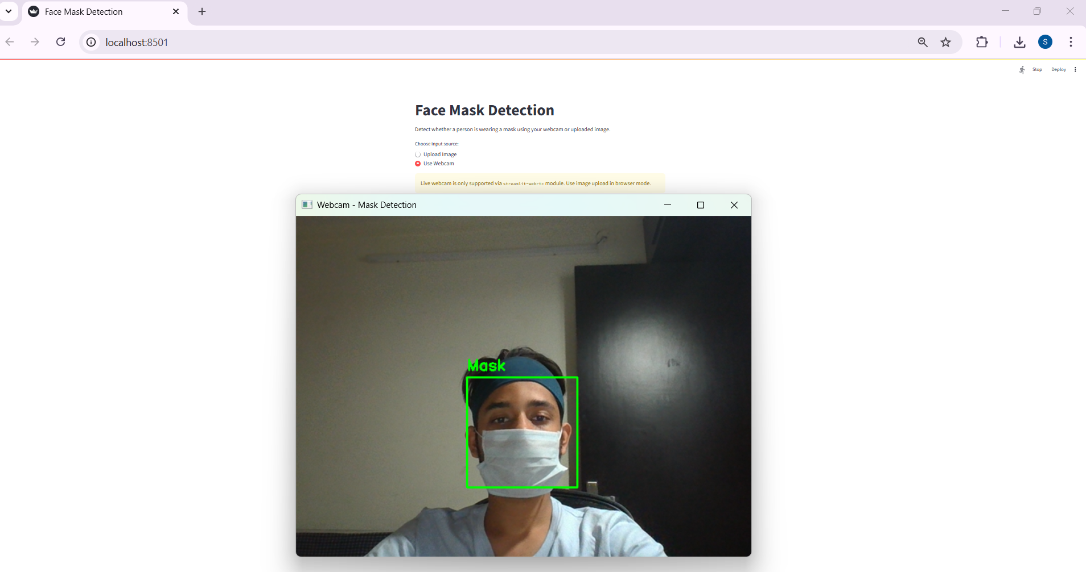

Slide 15


Slide 16
Future Work
Improve Detection Accuracy Fine-tune the model with a larger and more diverse dataset for better generalization.
Mobile Application Integration Deploy the system on Android/iOS platforms using TensorFlow Lite or MediaPipe.
Real-time Multi-Face Tracking Implement multi-face tracking with better speed and reduced lag.
Cloud-Based Monitoring Send alerts and captured frames to a centralized dashboard for monitoring in public areas.
Multilingual Audio Alerts Add support for voice alerts in multiple languages for wider usability.
Violation Logging System Automatically log date, time, and screenshot when someone is detected without a mask.

Slide 17
Conclusion
This project successfully demonstrates real-time face mask detection using OpenCV and a CNN-based deep learning model.
It helps promote public safety by ensuring individuals follow mask protocols.
The system can be deployed in public places, offices, or transport hubs for automated monitoring.
The integration of computer vision and AI shows great potential in solving real-world problems efficiently.

